Slide 1
IoT and Python Project - 2019
Access Control with Real-Time Face Recognition using a Raspberry PI

Slide 2
Application
This project can be used in offices to maintain a record of employees who have entered the office on that day, and the log will be sent over to the floor manager for their perusal. This system ensures that only registered employees will be allowed into the office.

Slide 3
Requirements:
Hardware requirements- 1. Raspberry Pi 4 2. Raspberry Pi Camera 3. 2 Channel-Relay 4. 12V Solenoid Lock 5. Jumper Wires 6. 12V Power Supply | Software Requirements- 1. OpenCV 2. OS- Raspbian Buster 3. Pi Camera driver for Raspberry Pi 4. NumPy

Slide 4
OpenCV
OpenCV is a cross-platform library using which we can develop real-time computer vision applications. It mainly focuses on image processing, video capture and analysis including features like face detection and object detection. OpenCV was built to provide a common infrastructure for computer vision applications and to accelerate the use of machine perception in the commercial products.OpenCV Python is nothing but a wrapper class for the original C++ library to be used with Python. Using this, all of the OpenCV array structures gets converted to/from NumPy arrays.

Slide 5
NumPy
NumPy is a general-purpose array-processing package. It provides a high-performance multidimensional array object, and tools for working with these arrays. It is the fundamental package for scientific computing with Python. All OpenCV array structures are converted to and from NumPy arrays.

Slide 6
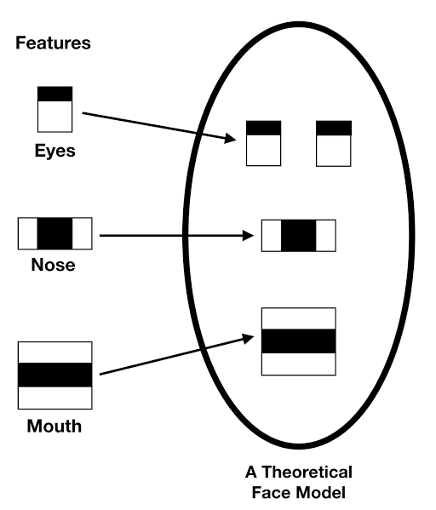
Haar Cascade Classifier
It is a classifier in which the Cascade function is trained by superimposing the positive image over a set of negative images.
It helps in the stages of face detection and feature extraction.

Slide 7
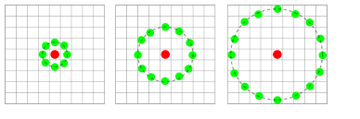
LBPH- Local Binary Pattern Histogram
Divide the examined window into cells (e.g. 16x16 pixels for each cell).
For each pixel in a cell, compare the pixel to each of its 8 neighbors (on its left-top, left-middle, left-bottom, right-top, etc.). Follow the pixels along a circle, i.e. clockwise or counter-clockwise.
Where the center pixel's value is greater than the neighbor's value, write "0". Otherwise, write "1". This gives an 8-digit binary number (which is usually converted to decimal for convenience).
Compute the histogram, over the cell, of the frequency of each "number" occurring (i.e., each combination of which pixels are smaller and which are greater than the center).

Slide 8
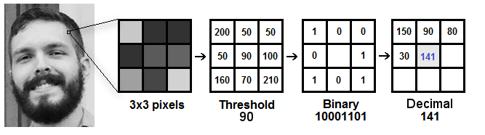
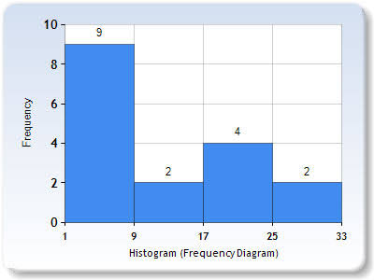

Slide 9
Why Raspberry Pi?
->A Raspberry Pi easily connects to the internet, whereas it is a little tricky to connect to the internet through an Arduino board.
->A Raspberry Pi can be programmed using a variety of languages,unlike an Arduino board that can only be programmed using Arduino, C/C++.

Slide 10
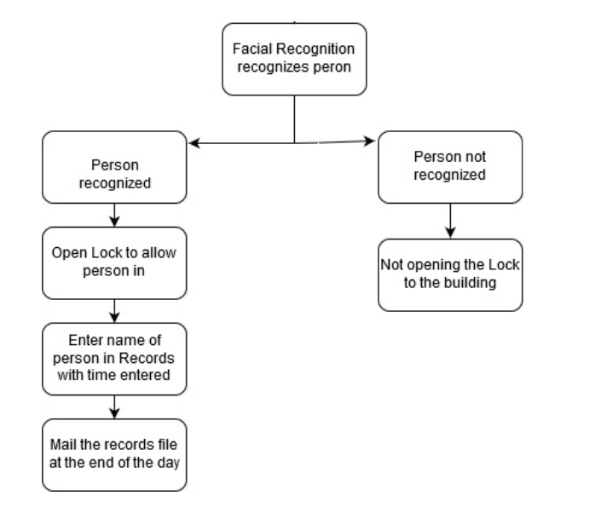
Flow Diagram

Slide 11
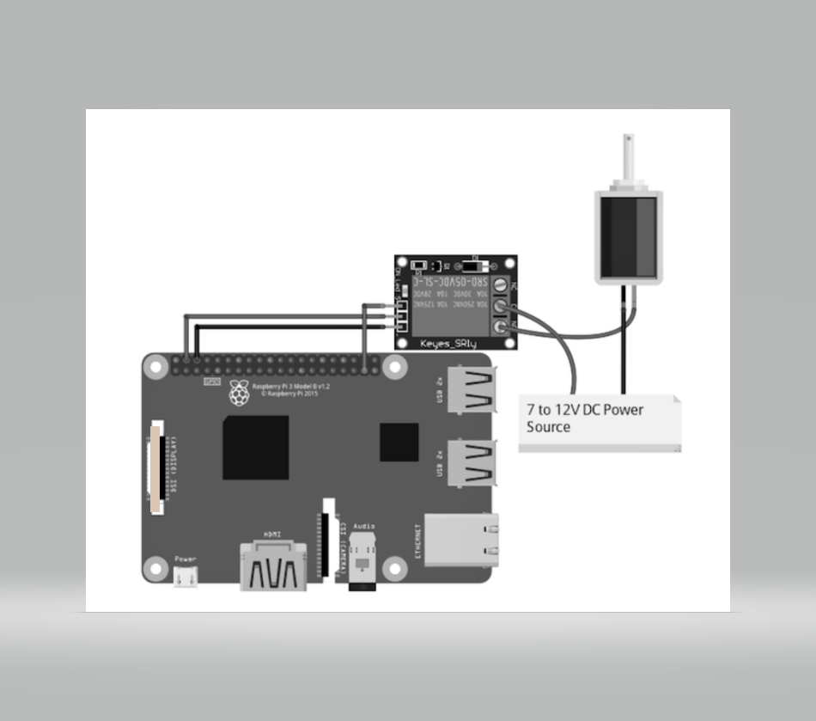
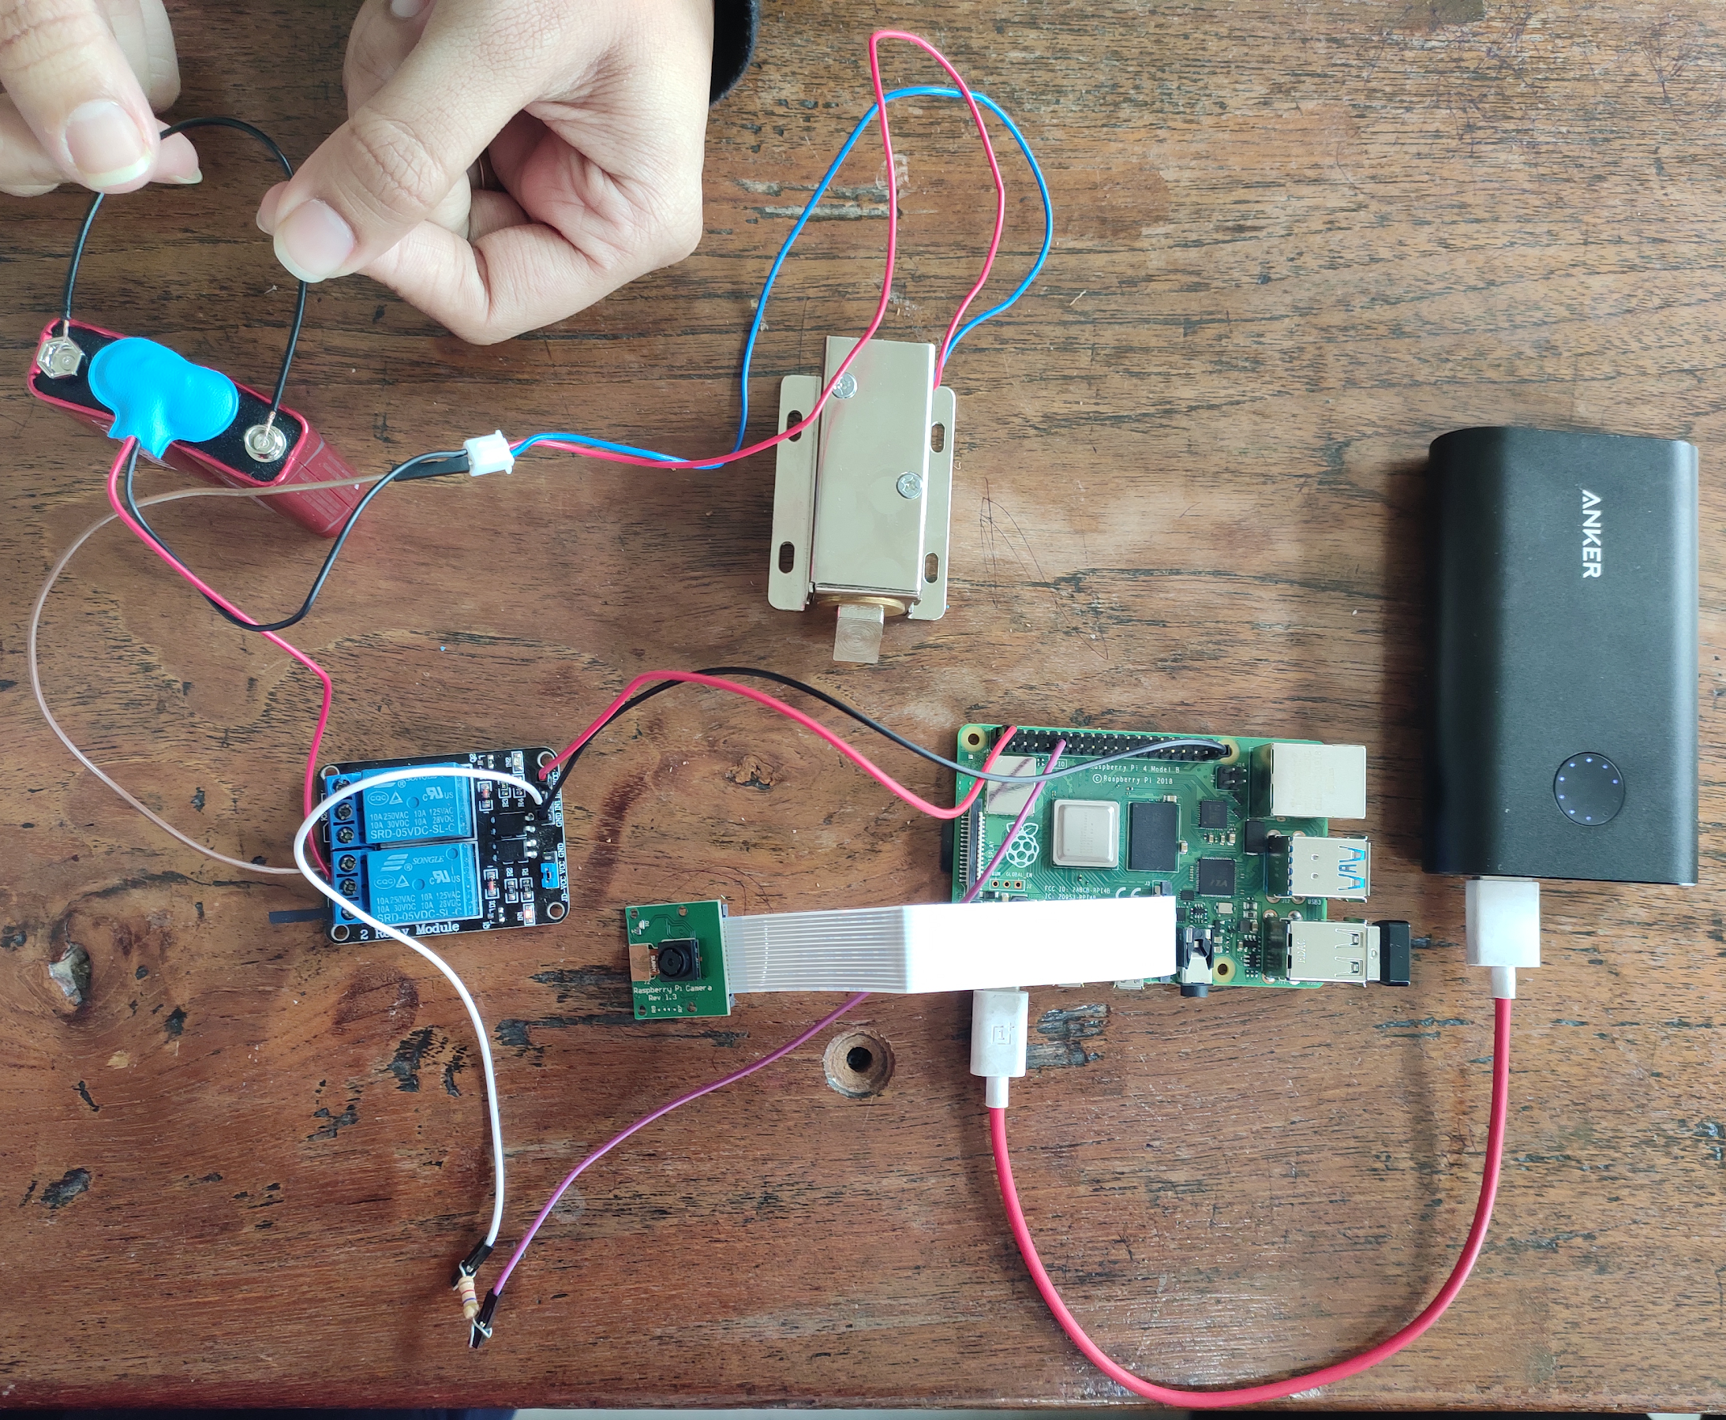
Circuit

Slide 12
Phases:
1. Face Detection and Data Gathering
2. Training Recognizer
3. Facial Recognition
4. Alert through email

Slide 13
Face Detection and Data Gathering:
Gathering images of the people to be identified is done in this phase.
A Python code is written to take in the faces of each person from various angles.
We use OpenCV, which is a library of programming functions used for Image processing.

Slide 14
Training Recognizer:
An ID will be assigned to each face, and each ID along with its respective face will be fed to the recognizer so that the recognizer can learn.
We use the LBPH (LOCAL BINARY PATTERNS HISTOGRAMS) face recognizer, which is included on the OpenCV package.

Slide 15
Facial Recognition:
If the ID and image match, the face will be recognized, and the lock will be unlocked. An unrecognized person will not be allowed to enter the building.
The confidence of the recognized face will be taken into account.

Slide 16
Email Alert:
If a face is recognized, the lock will be opened, and at the end of the day the floor manager will receive an email containing a record of all employee names along with the time of entry.
Simple Mail Transfer Protocol (SMTP) is the communication protocol used.The Simple Mail Transfer Protocol is a communication protocol for electronic mail transmission.

